Slide 1
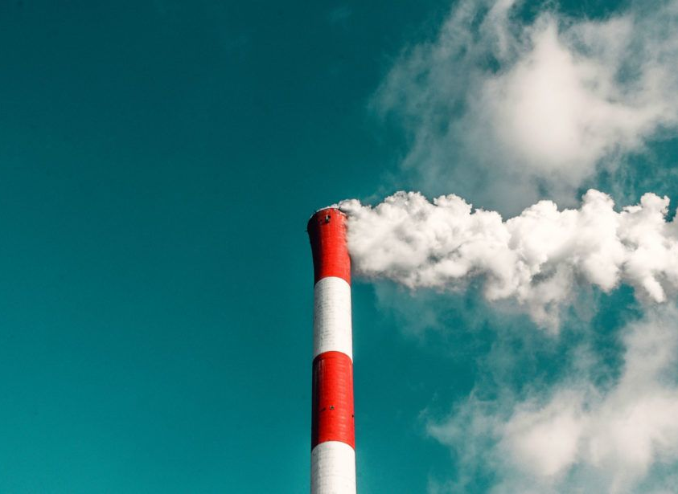
Trump vs climate
Has the American president’s crusade against the environment had an effect yet?

Slide 2
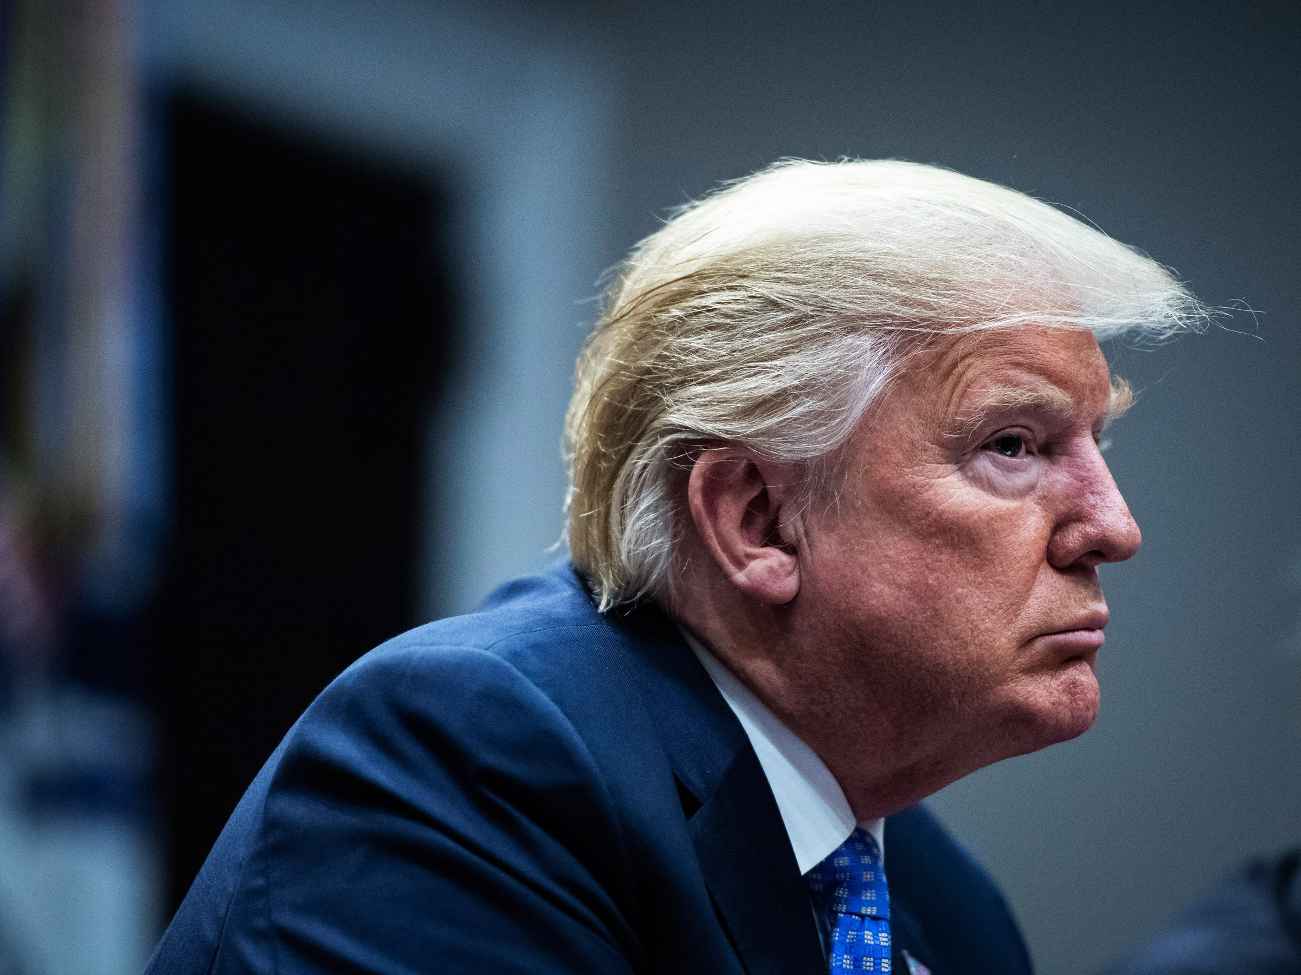

Slide 3
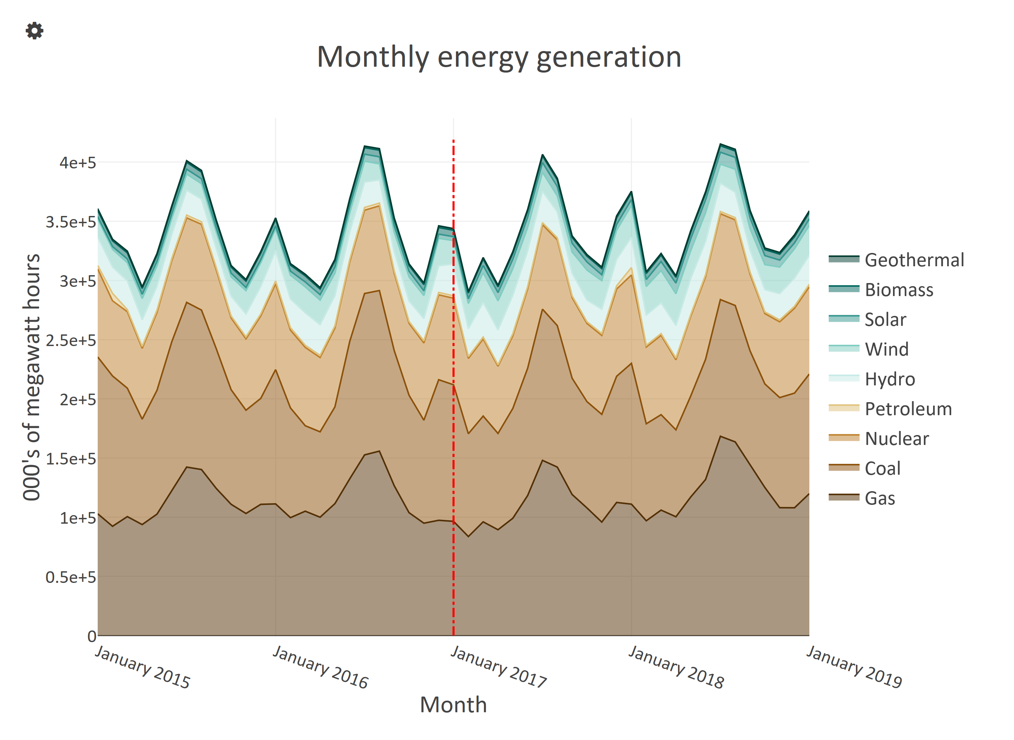
Notes:
?showlink=false

Slide 4
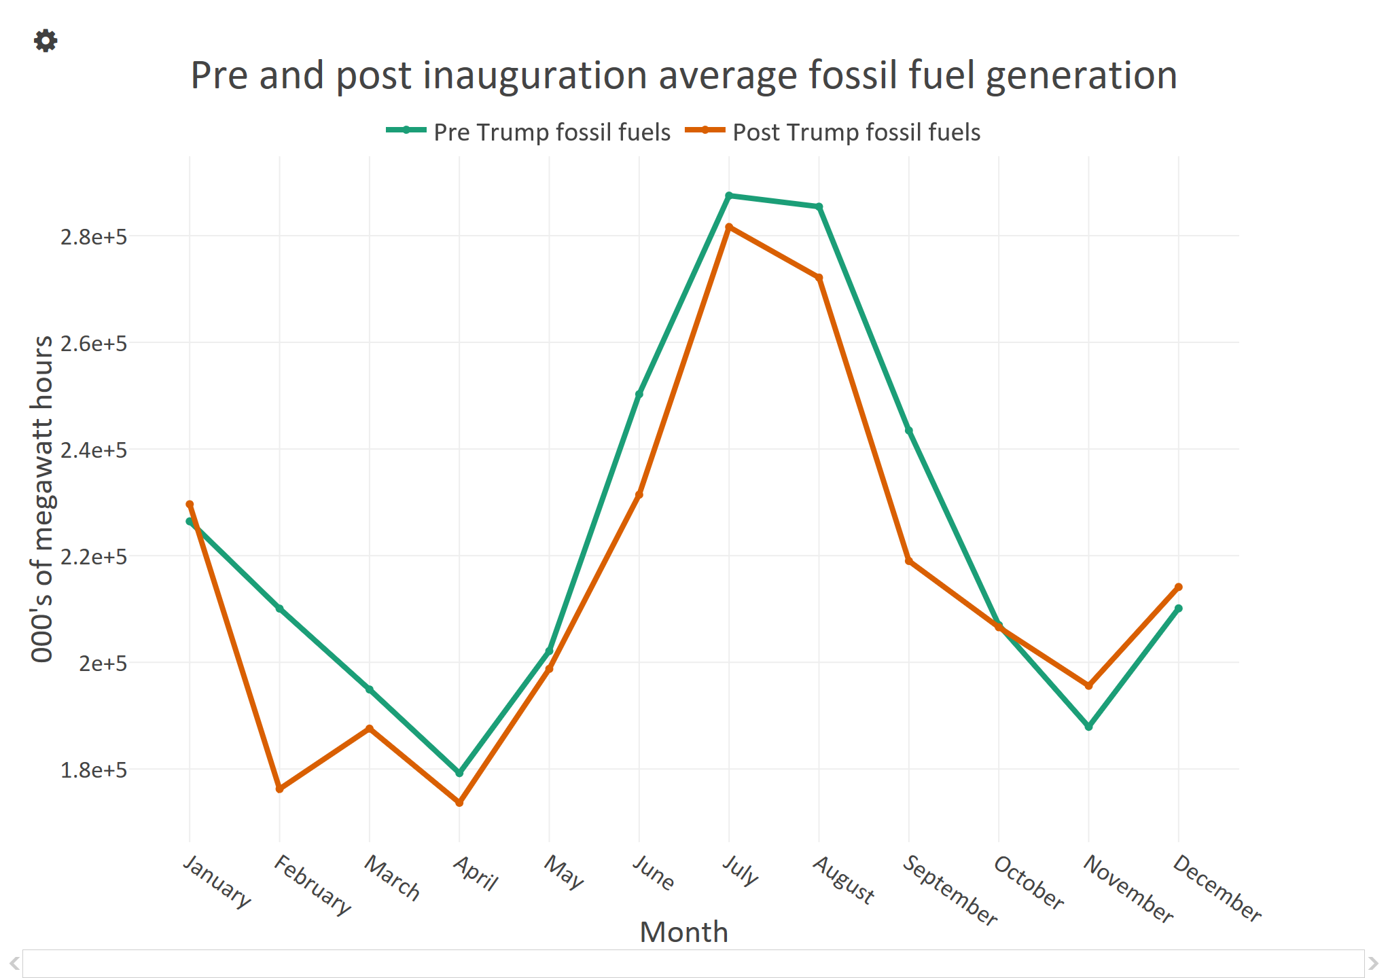
Notes:
?showlink=false

Slide 5
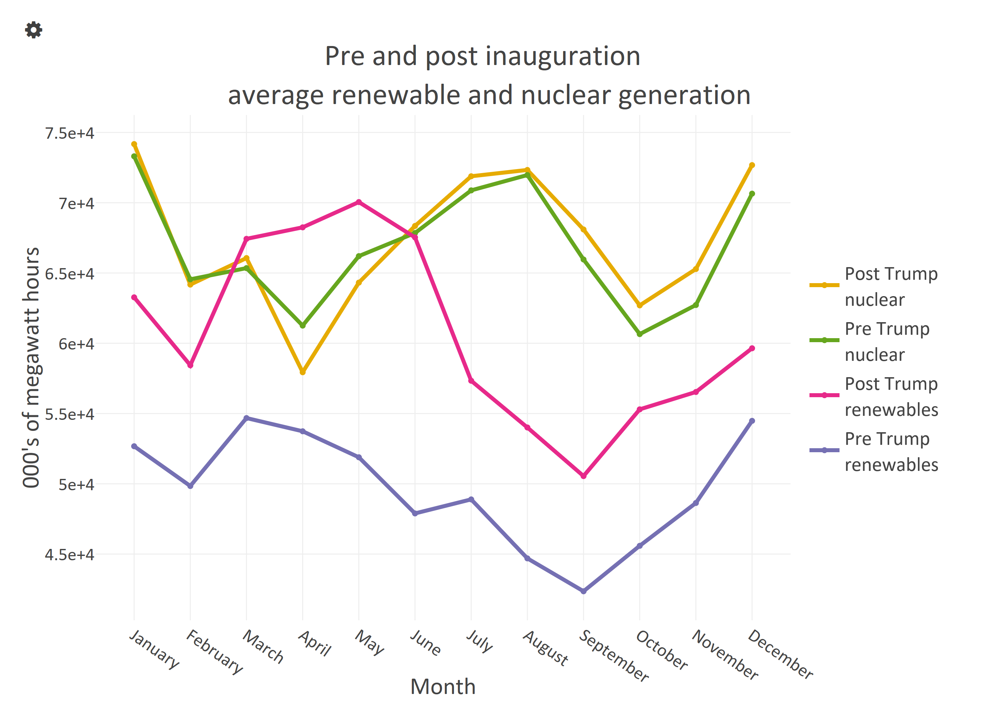
Notes:
?showlink=false

